Slide 1
Lavang
Dravyaguna Vigyan
Karpooradi Varg
Presented By:- Dr. Sudhendu Shekhar

Slide 2
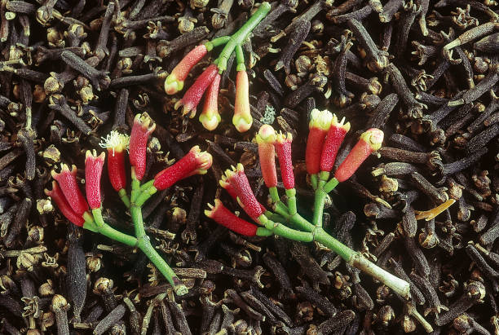
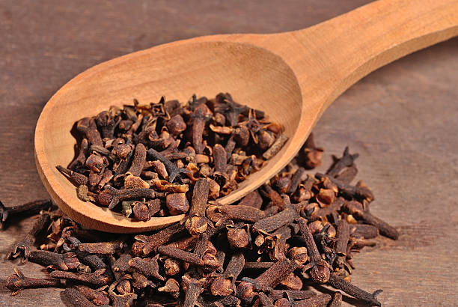
लवङ्गम्-लुनाति प्लिनति कफं। (यह कफ का छेदन करती है।)
Family:-
Myrtaceae
Botanical Name:-
Syzygium aromaticum Linn.

Slide 3
Classical Categorisation
Bhava Prakasha Nighantu Karpuradi Varga
Dhanwantri Nighantu Chandanadi Varga
Kaiydeva Nighantu Aushadhi Varga
Raja Nighantu Chandanadi Varga
Priya Nighantu Shatpushpadi Varga
Vaidya Manorama
Sodhal Nighantu
Charak Samhita ( Sutra sthan, Chikitsa sthan)
Astangh Hridya, Uttar sthan, Mukh Roga
Raj Vallabh Nighantu
Atrey Samhita

Slide 4
Synonyms & Properties
Lavang
Devkusum
Shrisangya
Shriprashunak
It is pungent and bitter in taste
light in nature
good for eyes
cold in potency
लवङ्गं देवकुसुमं श्रीसंज्ञं श्रीप्रसूनकम् ।
लवङ्गं कटुकं तिक्तं लघु नेत्रहितं हिमम् ।।
(भा०प्र०नि० कर्पूरादि वर्ग: 48)

Slide 5
देव कुसुम - देवानाम कुसुमं यादव कुसुमेषु देव इव राजदन्तादिवत | यादव देव योग्यं कुसुमं इति देव कुसुमं |
The flowers are used to worship God and it is considered to be the best flower among the flowers.
श्री संज्ञा - Lavanga is auspicious.
श्री प्रसून - Flowers are beautiful.

Slide 6
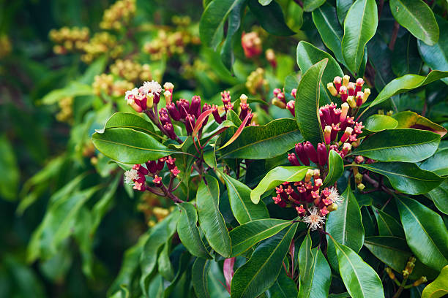
Morphology
Tree:- It is a pyramidal evergreen tree, 8-10m high or more.
Leaves- simple, lanceolate, , gland-dotted, fragrant.
Flowers-buds— cyme, small clusters of branches, greenish; pink at maturity, aromatic.
Fruits- fleshy, dark pink drupes.
Seeds- oblong, grooved in one side.

Slide 7
Karma
दीपनं पाचनं रुच्यं कफपित्तास्त्रनाशकृत् । कृष्णाां छर्दि तथाऽऽध्मानं शूलमाशु विनाशयेत् ।
कासं श्वासञ्च हिक्काञ्च क्षयं क्षपयति ध्रुवम् ।।
(भा०प्र०नि० कर्पूरादि वर्ग: 49)
भ
It promotes digestive fire. It is digestive in nature and enhances taste. It manages the cough, pitta, blood disorders, thirst, vomiting, pain, hiccups and abdominal distention.

Slide 8
Habitat & Distribution :-
Originally from Malaya – Sailibius island. At present it is being cullivated in Sumatra) Malakka, Zanjibar. Penang. Mauritius, Bornia, Brazil) Guyana. West Indies and Travancore in Southern India.
Properties:-
Rasa : Tikta, Katu
Guna : Laghu, Snigdha
Vipãka : Katu
Virya : sita

Slide 9
Chemical Composition
Gum and volatile oil 16-20%. resin 6%, euginine or cariophyllin, tanin, gum. Clove oil contains 85-92% eugenol. aryophyllene, eugenol, furfural, methyl alcohol, methylbenzoate, valeraldehyde, vanillin, eugenitine, isoeugenitol, eugenine, eugenone, naphthalene, caryophellene oxide etc.

Slide 10
External uses
It is stimulant, antimicrobial and tikshna, so it is applied locally in headache and sinusitis. Chewing of clove is useful in stomatitis and skin disorders. Clove oil is used for massage in rheumatoid arthritis, sciatica, backache.

Slide 11
Internal uses
Digestive system : it is an appetizer and digestive. it stimulates salivating glands to increase salivary secretion. Carminative , analgesic ,liver stimulant. It is useful in anorexia, loss of appetite, flatulence, abdominal colic, hyperacidity, nausea.
Circulatory. system : Stimulates heart and circulation, increases blood pressure, syphilis. Useful in blood disorders because of pungent and sheeta properties.

Slide 12
Respiratory system : Reduces cough, tuberculosis, foul smell and breathlessness, stimulates respiration mucosa causing expectoration.
Reproductive system : Aphrodisiac, purifies breast milk.
Skin : Clove is useful in many skin disorders by its stimulating action on skin.
Temperature: Useful in fever to reduce temperature. Clove boiled in water is a good remedy for fever.

Slide 13
Therapeutic Uses
Pain— Lavanga is pounded and applied with warm water externally. (Vaidya Manorama 12/6)
Visüchikã— water boiled with clove is filtered and given in Visuchika. (Vrind Madhav 6/62)
Trishnã— Fresh juice of Lavanga may be useful in trishna.
(Vrind Madhav 6/62)

Slide 14
Formulation
Avipattikar Churna
Lavangadi Vati
Khadiradi Gutika
Devkusumarka Lavangadi Churna

Slide 15


