Slide 1

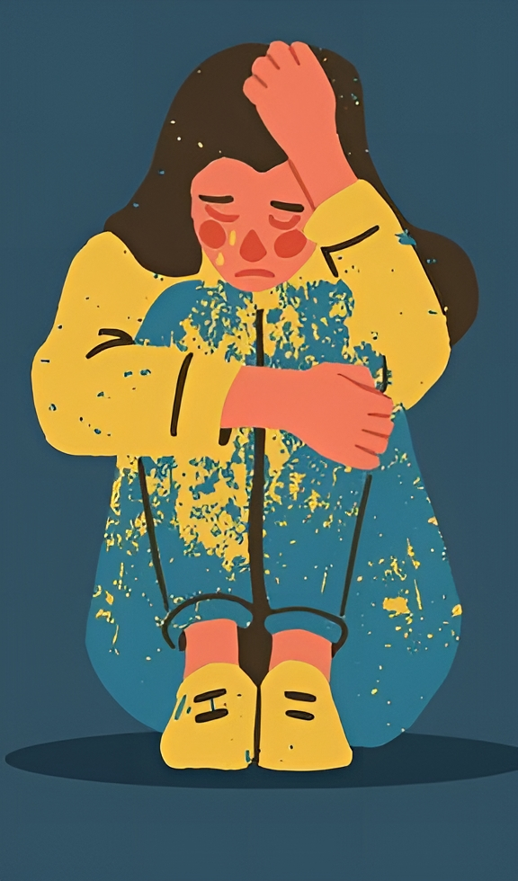
AYURVEDIC SINGLE HERBS USED IN HALLUCINATION
Presented By:-
Sudhendu Shekhar
M.D. Scholar
Department Of Dravyaguna Vigyan
Patanjali Bhartiya Ayurvigyan Evam Anusandhan Sansthan, Haridwar

Slide 2
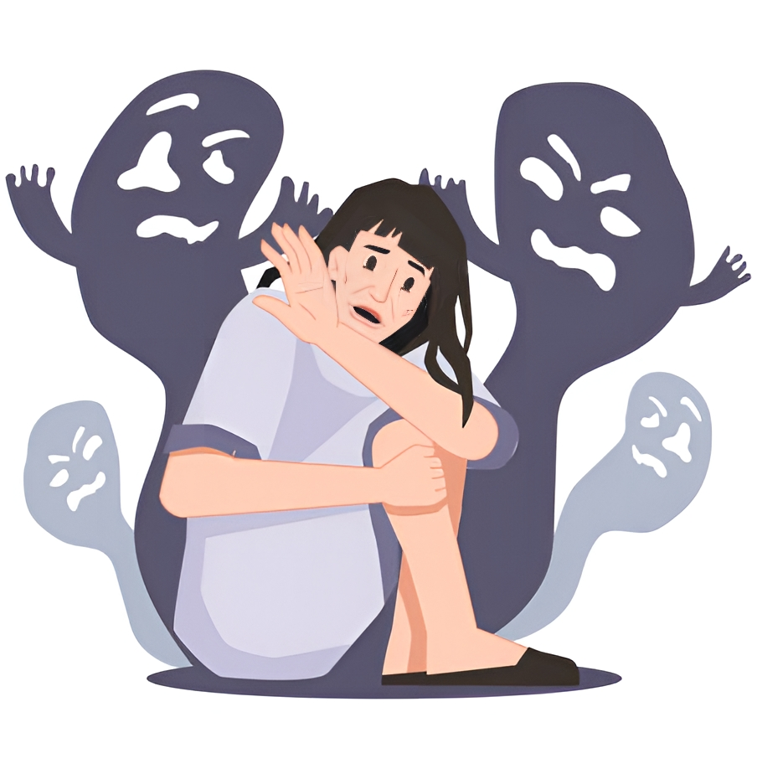
Introduction
Definition Of Hallucinations:- A false perception of a sight, sound, smell, taste, or touch that seems real but is not.
Hallucinations in Ayurveda:- In Ayurvedic classics, hallucinations were called false perceptions (mithyajnana), illusions (maya), infatuations (moha), or confusion (bhrama). Hallucinations were not independent but a symptom of mental disorder (manasa roga).

Slide 3
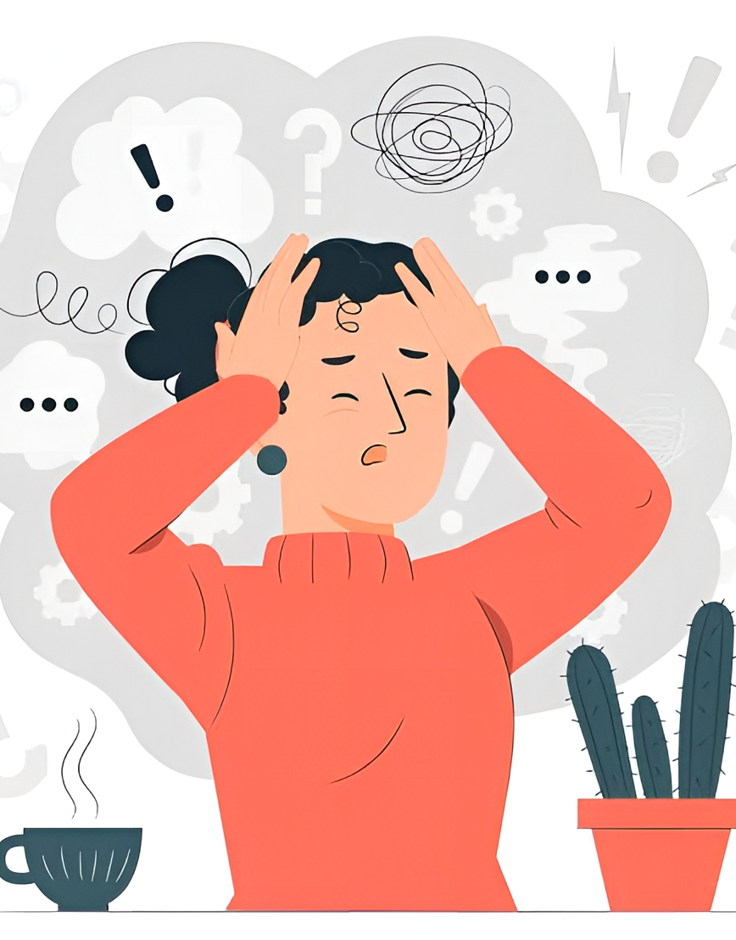
Manas Vikar:-
AYURVEDIC SINGLE HERBS USED IN HALLUCINATION
2
Acharya Charaka described that rajas and tamas are two factors that influence the mind and lead to symptoms of mental disorders.
In pathogenesis of a mental disorder called “atatvabhinivesha” , Acharya Charaka explains that an increase in rajas and tamas clouds the mind (manas) and intellect (buddhi).
The hridaya (seat of manas) is disrupted by an imbalance of doshas (tridosha).

Slide 4
Manas Vikar:-
Acharya Charaka outlines eight fundamental psychological factors that are adversely impacted in various psychiatric disorders.
These factors include the mind (manas), cognition (buddhi), orientation and responsiveness (sangya gyan), devotion (bhakti), habits (sheela), psychomotor activity (chesta), and conduct (achara).
Excessive activation of rajas (action) or tamas (inertia) disrupts the mind’s balance, which subsequently impacts the tridosha (vata, pitta, kapha).
When this balance is completely lost, it can lead to a mental disorder.

Slide 5
HALLUCINATIONS IN UNMADA
उन्मादं पुनर्मनोबुद्धिसंज्ञाज्ञानस्मृतिभक्तिशीलचेष्टाचारविभ्रमं विद्यात् ॥ (च.नि. 7/5)
Acharya Charaka defined unmada or mental disorder as instability of mind (manas), intellect (buddhi), deranged perception of all sensory stimulus or loss of orientation of time, situation and place (sangya gyan), memory (smriti), inclination (bhakti), mannerism (sheela), activities (chesta) and conduct (achara).

Slide 6
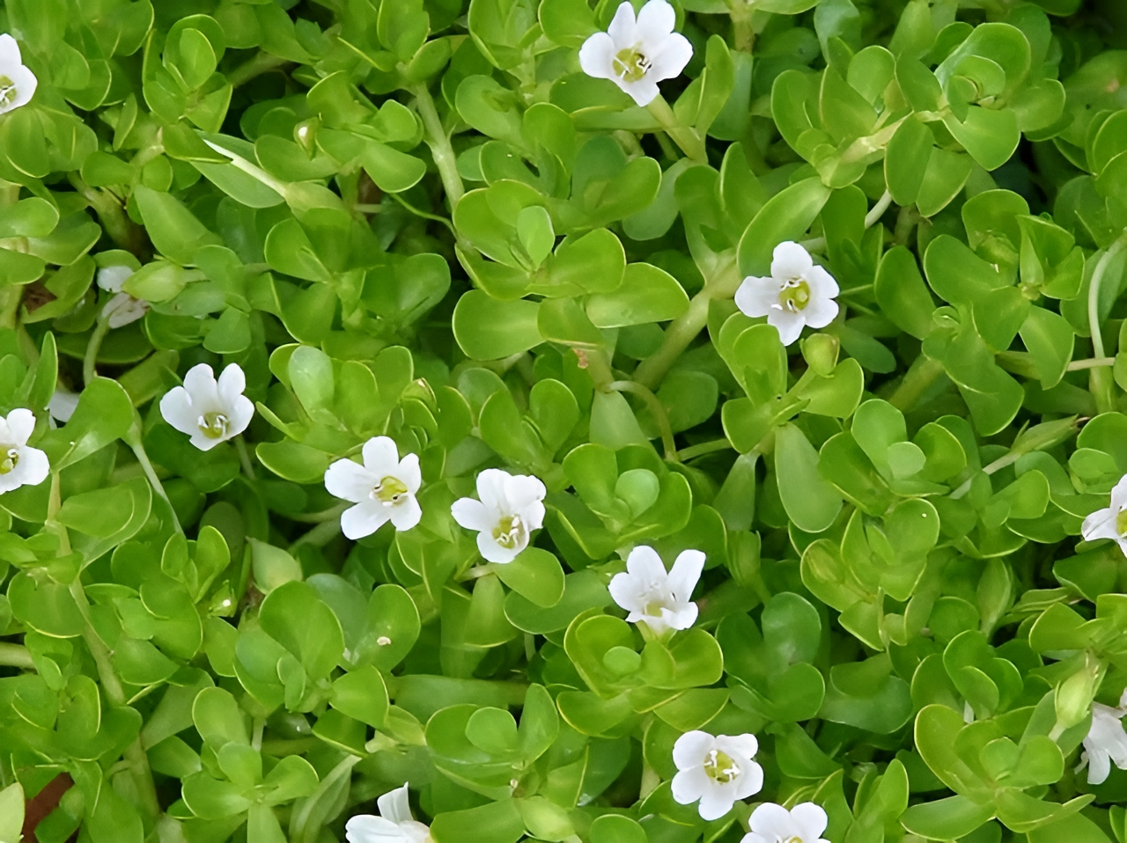
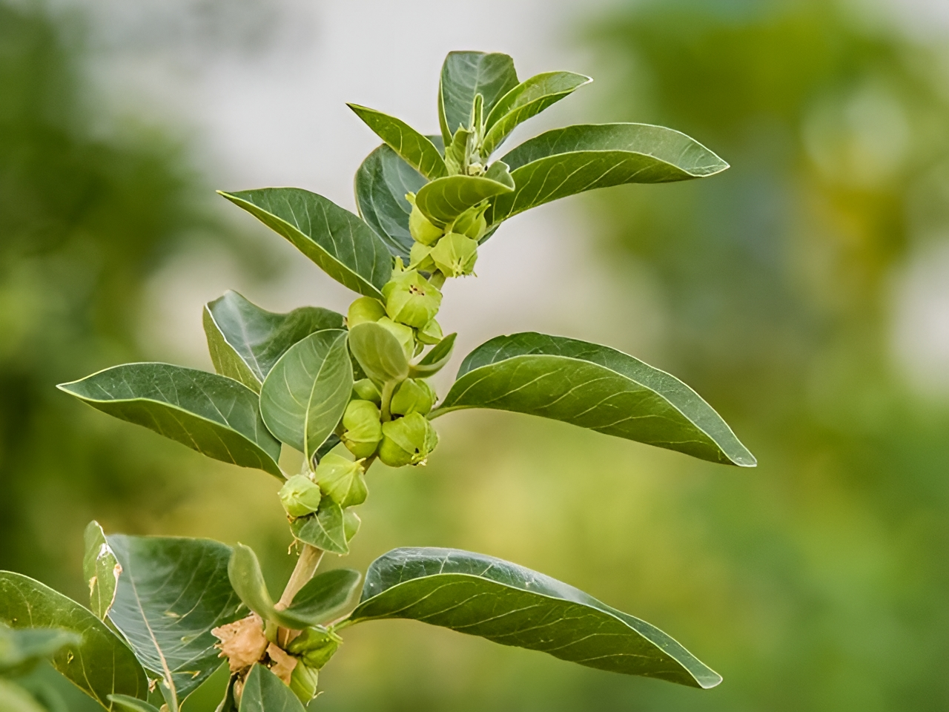
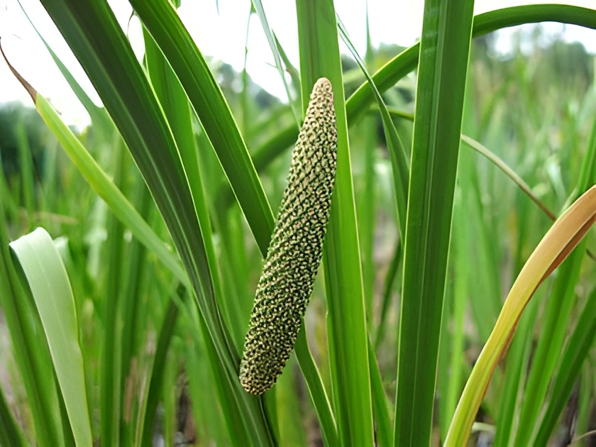
Ayurvedic Single Herbs Used In Hallucination
1 | Brahmi (Bacopa monnieri L.)
2 | Ashwagandha ( Withania somnifera D.)
3 | Vacha (Acorus calamus L.)
Brahmi (Bacopa monnieri L.) Ashwagandha ( Withania somnifera D.) Vacha (Acorus calamus L.)

Slide 7
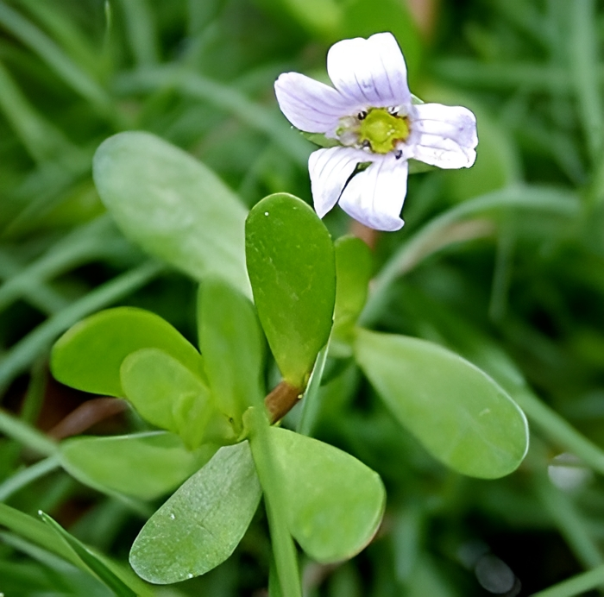
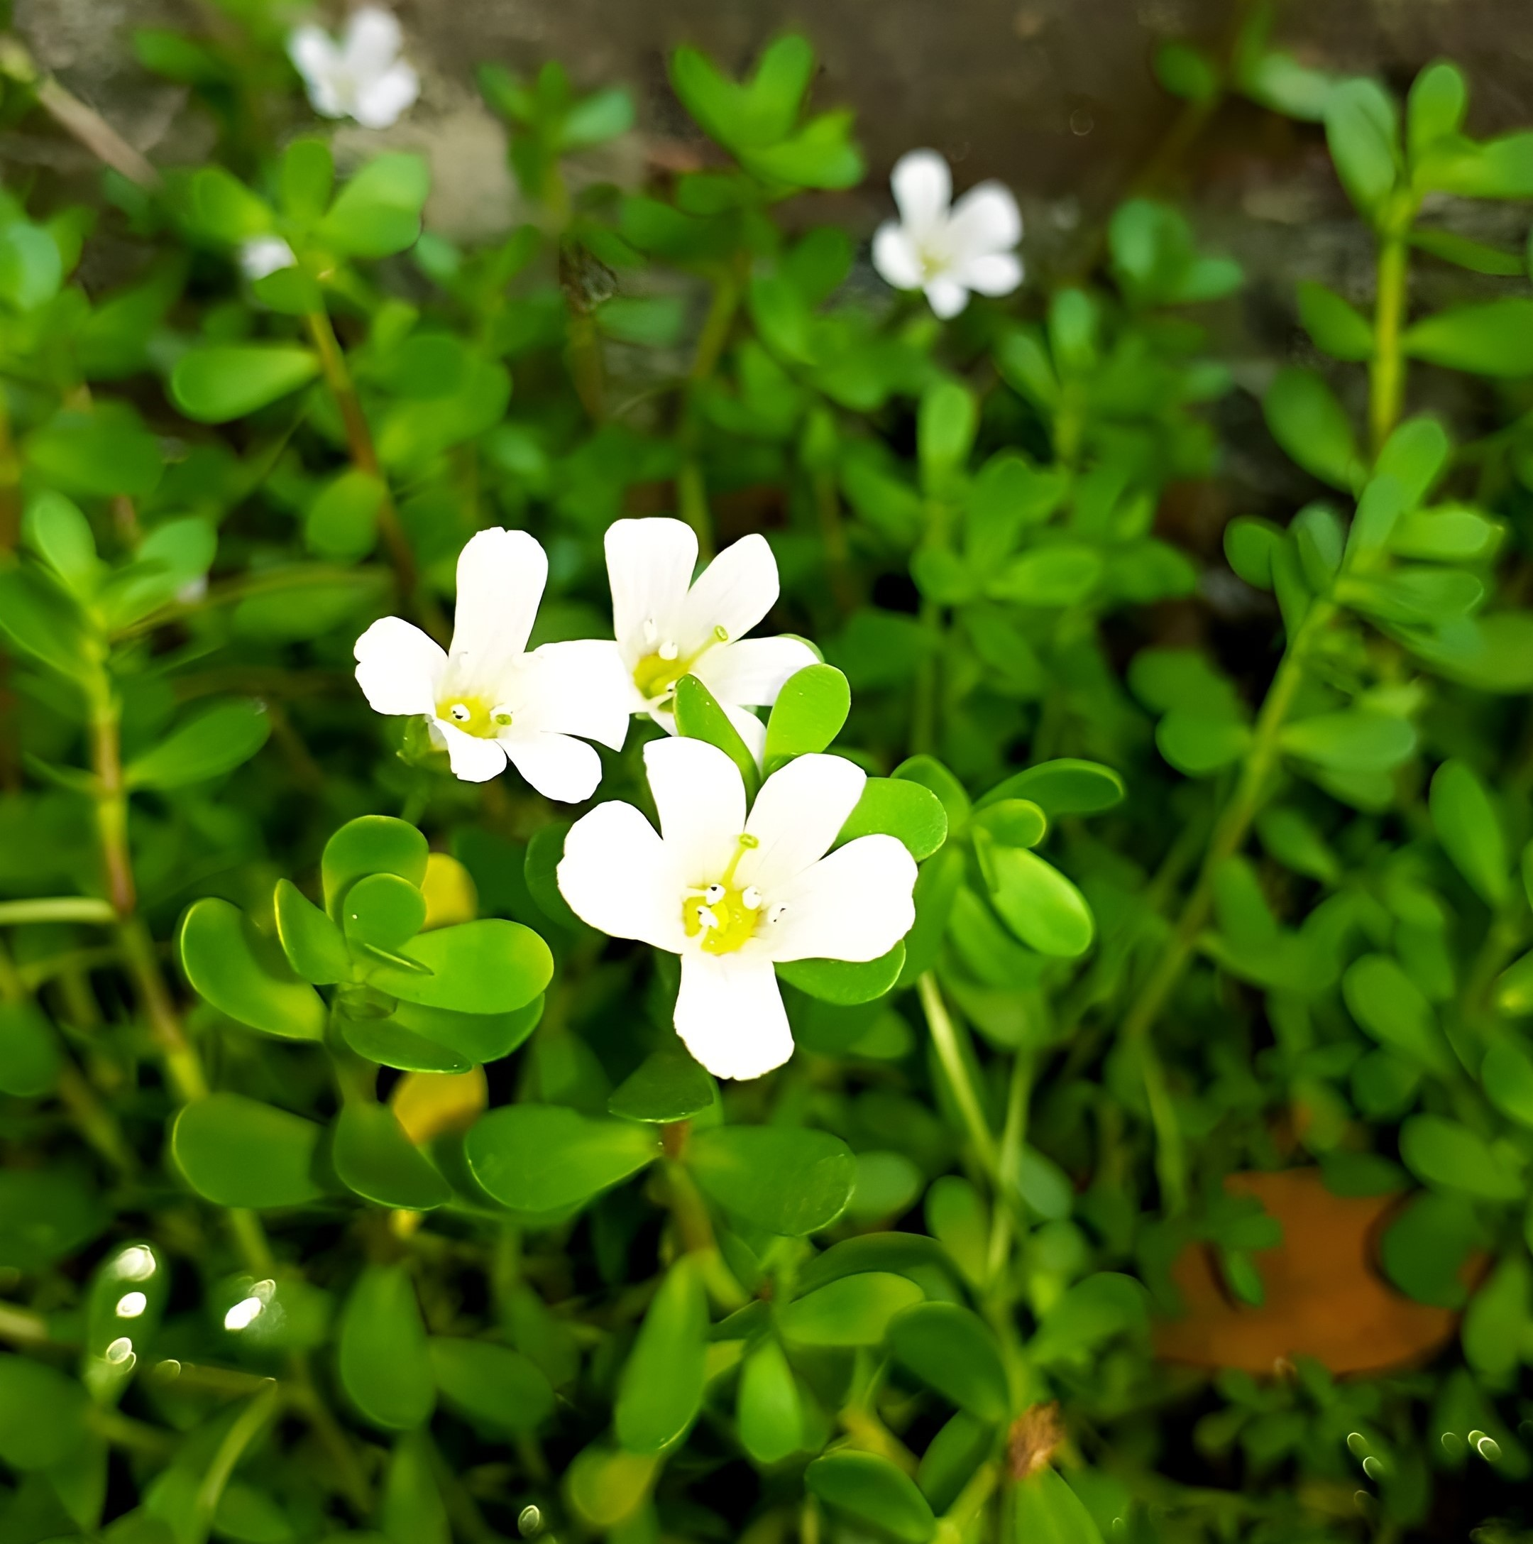
Brahmi
AYURVEDIC SINGLE HERBS USED IN HALLUCINATION
6
Botanical Name:- Bacopa monnieri L.
Family:- Scrophulariaceae

Slide 8


Brahmi
AYURVEDIC SINGLE HERBS USED IN HALLUCINATION
7
ब्राह्मी हिमासरा तिक्ता लघुर्मेध्या च शीतला । कषाया मधुरा
स्वादुपाकाऽऽयुष्या रसायनी || (भाoप्रoनिo गुडूच्यादिवर्गः 280)
स्वर्या स्मृतिप्रदा कुष्ठपाण्डुमेहास्त्रकासजित् । विषशोथज्वरहरी
तद्वन्मण्डूकपर्णिनी || (भाoप्रoनिo गुडूच्यादिवर्गः 281)
* Rasa (Taste):- Bitter, Astringent & Sweet.
* Guna (Qualities):- Laghu [ightness)
* Veerya: -Sheetal (Cool potency)
* Vipaka:- Sweet
Brahmi eases the motions. It help in boosting brain strength, increases lifespan, acts as rasayan, maintains vocal cords. Along with this, it also in creases the concentration, helps in skin and blood disorders.

Slide 9
Brahmi
AYURVEDIC SINGLE HERBS USED IN HALLUCINATION
8
Mode Of Action:-
Brahmi has an active compound known as bacosides positively influence brain cells that regenerate the brain tissues.
(Ref.:- A Manap, A Syamima, S Vijayabalan, P Madhavan, Y Y Chia, A Arya, E H Wong, F Rizwan, U Bindal,and S Koshy. 2019. “Bacopa Monnieri , a Neuroprotective Lead in Alzheimer Disease: A Review on Its Properties, Mechanisms of Action, and Preclinical and Clinical Studies.” Drug Target Insights 13:117739281986641. doi: 10.1177/1177392819866412)
Tikta Rasa are predominant in Brahmi and have Tridosh hara property with Vata hara guna , which is very much useful in psychological disorders.
Therapeutic Usage:-
Powder of leaves are used in Depression, Hallucination And Mental disorder.

Slide 10
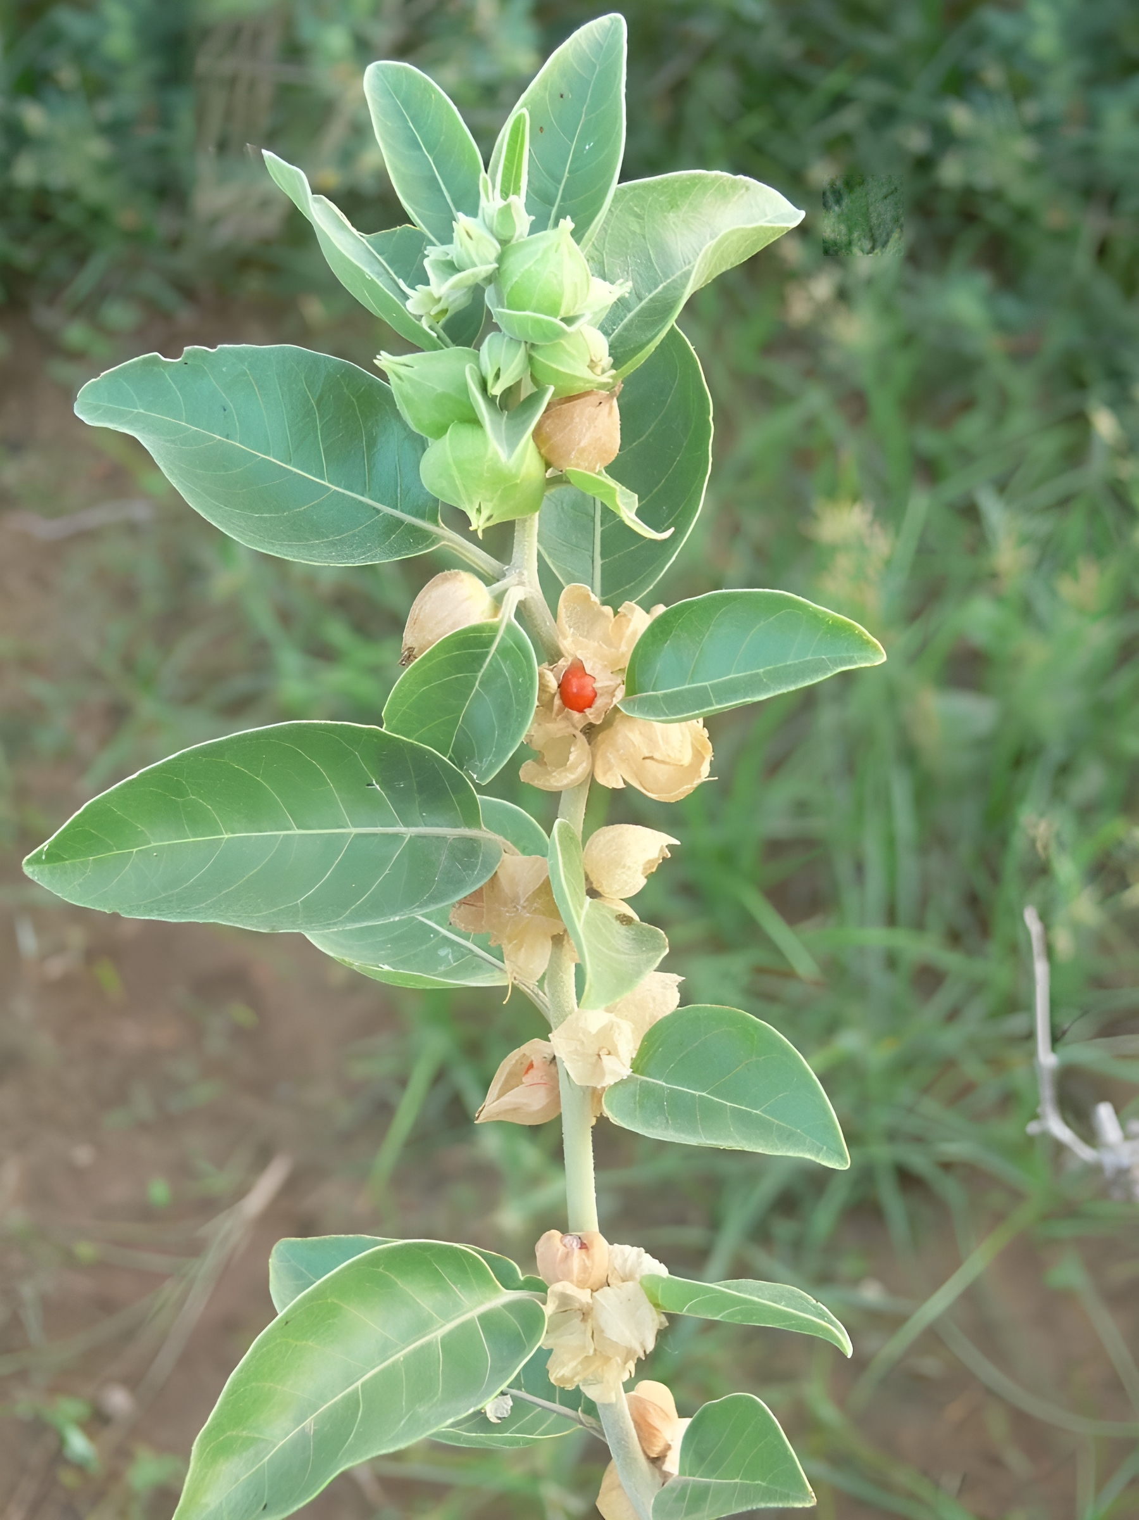
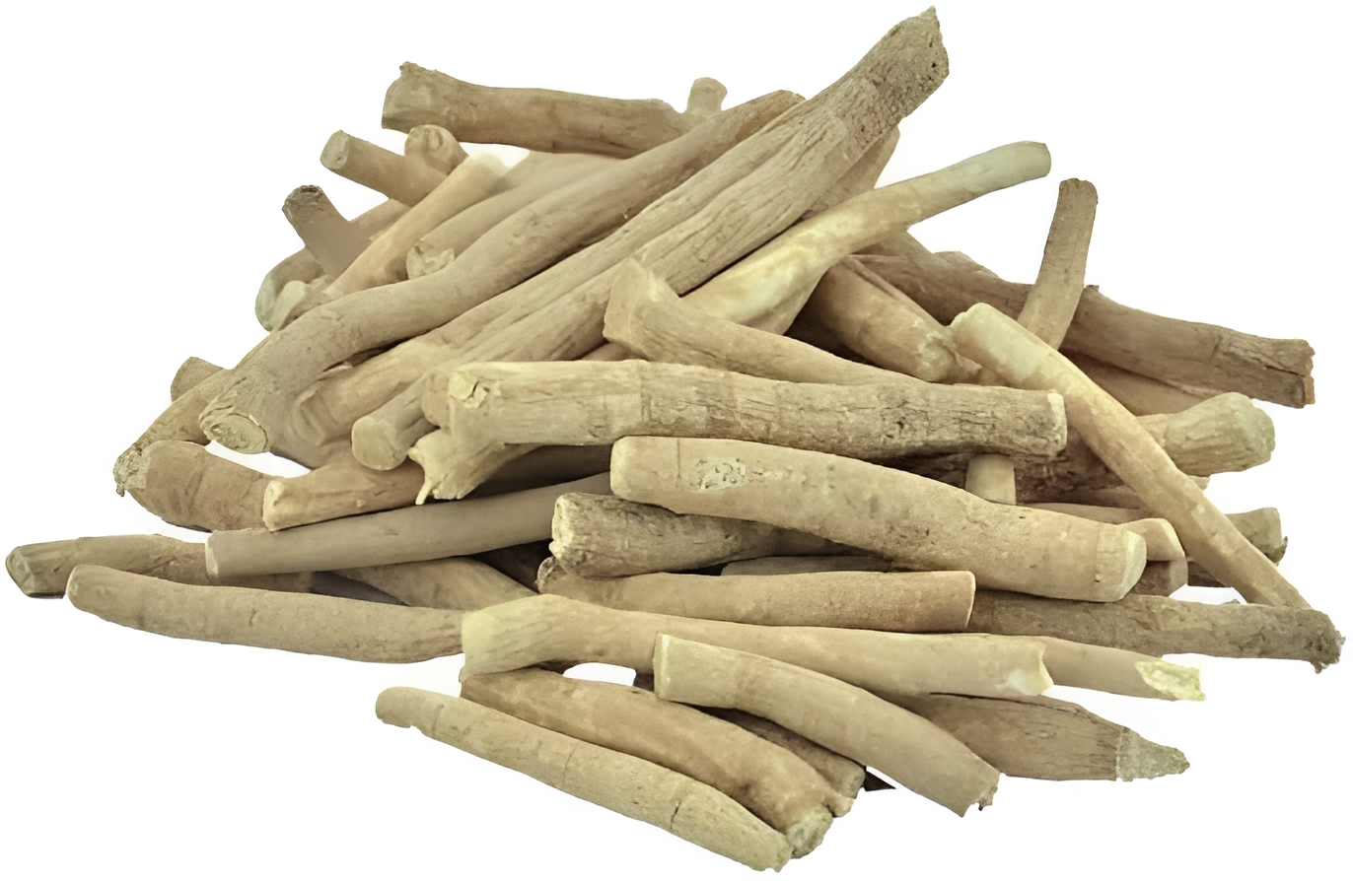
Ashwagandha
AYURVEDIC SINGLE HERBS USED IN HALLUCINATION
9
Botanical Name:- Withania somnifera D.
Family:- Solanaceae

Slide 11

Ashwagandha
AYURVEDIC SINGLE HERBS USED IN HALLUCINATION
10
अश्वगन्धाऽनिलश्लेष्मश्वित्रशोथक्षयापहा । बल्या रसायनी तिक्ता कषायोष्णाऽतिशुक्रला || (भाoप्रoनिo गुडूच्यादिवर्गः 190)
Rasa: - Tikta , Kashaya
Guna: - Snigdha, Laghu
Veerya: - Ushna
Vipaka: - Katu
Effect on tridoshas: - Balances tridoshas, especially Kapha and Vata
It is widely used in treating anxiety, skin disorders, depression, and swelling. Also improves blood circulation, a very good anti-oxidant, act as a nervine tonic and soothes nerves. Hence it is useful to relieve numbness. Ashwagandha improves quality and quantity of sperm count. It act as rasayana. It mainly pacifies Kapha (cough, tonsillitis, sinusitis, asthma) and Vata dosh (osteoarthritis, headache, etc.)

Slide 12

Ashwagandha
AYURVEDIC SINGLE HERBS USED IN HALLUCINATION
11
Mode Of Action:-
Extracts of Ashwagandha produce GABA-like activity, which may account for the herb's anti-anxiety effects.
GABA (Gamma Amino-butyric acid) is an inhibitory neurotransmitter in the brain. Its function is to decrease neuron activity and inhibit nerve cells from over firing. This action produces a calming effect. Excessive neuronal activity can lead to restlessness and insomnia, but GABA inhibits the number of nerve cells that fire in the brain, and helps to induce sleep, uplift mood, and reduce anxiety.
(Ref.:- G.Singh, P.K.Sharma, R.Dudhe, S.Singh. Biological activities of Withania somnifera.
Annuals of Bio-logical Research, 2010, 1(3):56-63.)

Slide 13
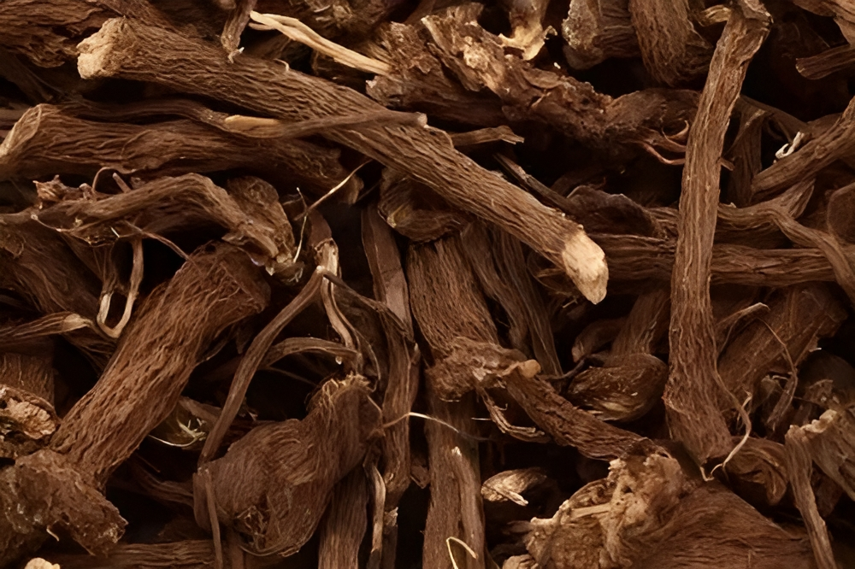
Vacha
AYURVEDIC SINGLE HERBS USED IN HALLUCINATION
12
Botanical Name:- Acorus calamus L.
Family:- Araceae

Slide 14
Vacha
AYURVEDIC SINGLE HERBS USED IN HALLUCINATION
13
वचोग्रगन्धा कटुका तिक्तोष्णा वान्तिवह्निकृत् । विबन्धाघ्मानशूलघ्नी शकृन्मूत्रविशोधनी।। अपस्मारकफोन्मादभूतजन्त्वनिलान्हरेत् ।।
(भाoप्रoनिo हरीतक्यादिवर्गः 103)
Rasa - Katu , Tikta
Guna - Laghu , Teekshan
Vipaka - Katu
Veerya - Ushan
Dosha Karma - Balances Vitiated Kapha and Vata Doshas
Prabhava - Medhya
It has an offensive nauseating smell, induces vomiting, improves digestion, relieves constipation, bloating and abdominal colic. It cleanses feces and urine, also useful in epilepsy, Kapha disorders, schizophrenia, and psychological disorders. It is also useful in worm infestation and Vata disorders like neuralgia, paralysis, etc.

Slide 15
Vacha
AYURVEDIC SINGLE HERBS USED IN HALLUCINATION
14
Mode Of Action:-
Vacha have a active compound acorin, stimulates the brain and increases alterness and focus. Improves cerebral circulation, enhances speech. Vacha acts a remedy for mental stagnation of all degree.
Tikta Rasa are predominant in Vacha and have Tridosh hara property with Vata hara guna , which is very much useful in psychological disorders.
Therapeutic Usage:-
Powder of Roots of Vacha mix with Milk or Honey and used in Unmada , Apasmar And any Mental disorder.

Slide 16

AYURVEDIC SINGLE HERBS USED IN HALLUCINATION

