Slide 1
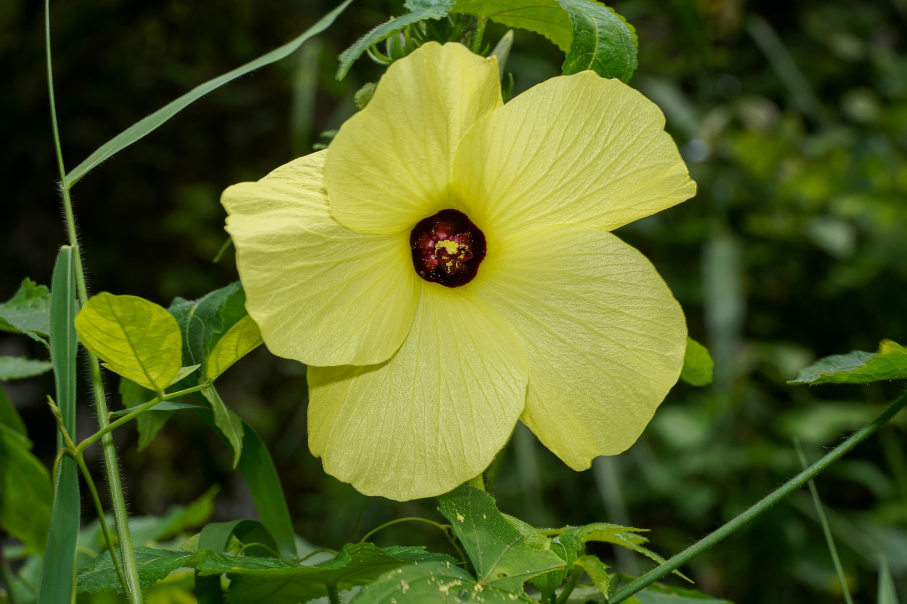
Lata kastoori
Presented by - Vd. Jai Shree Yadav
P.G 1st Year
Department of Dravyagun

Slide 2
What we call it !
Botanical name - Abelmoschus moschatus , Linn
Hibiscus abelmoscheus L.
Family - Malvaceae
Basonym- कस्तूरीवत् गन्धत्वात्
Hindi name - Musk Dana / kastoori bhindi
English name - Musk seed , Musk mallow

Slide 3
Classical categorisation
Kaidev nighantu - aushadh varg
Bhav prakash - poorva khanda, Mishra prakarana , karpooraadi varg

Slide 4
Nam roop vigyan
Lata kasturi - seeds odour resembles musk
Gandhpoora - aromatic seeds
Katuka & katukahvaya - pungent fruits
(Both used by aacharya charak and aachrya shushrut)

Slide 5
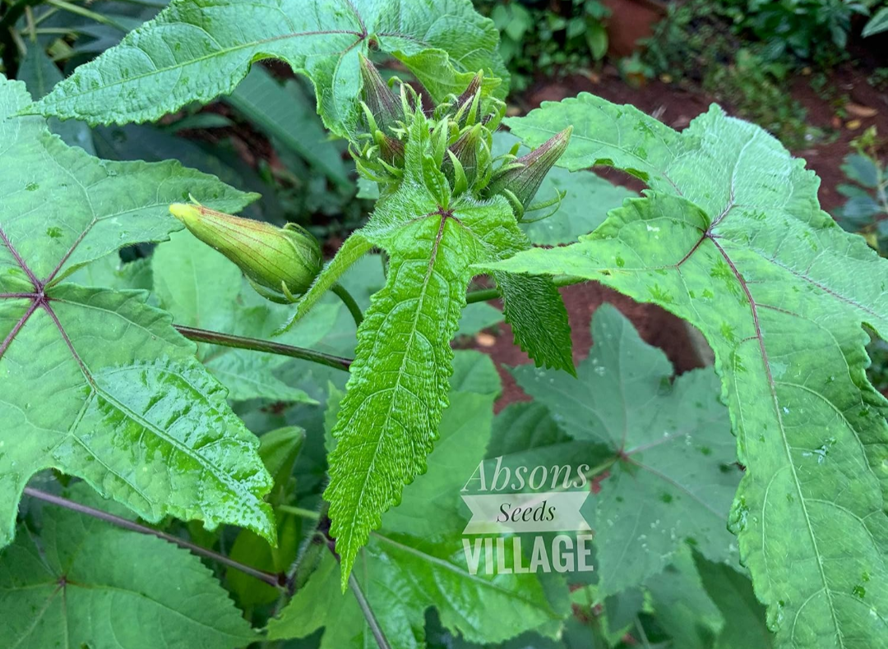
How we identify it ?
Hirsute( covered with hairs)annual herb
Found in South region of India
Leaves -
Cordate Palmately ( resembles like hands ),
Divided into 3-7 lobes Irregularly toothed k/a serrate margins
Hairy surface

Slide 6
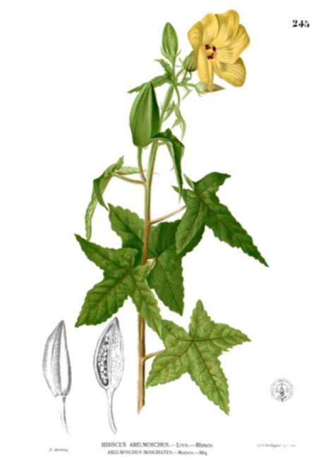
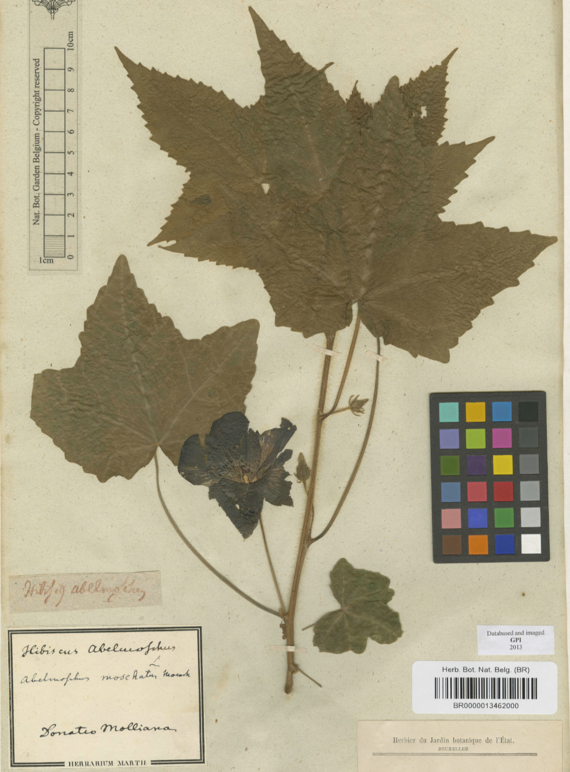

Slide 7
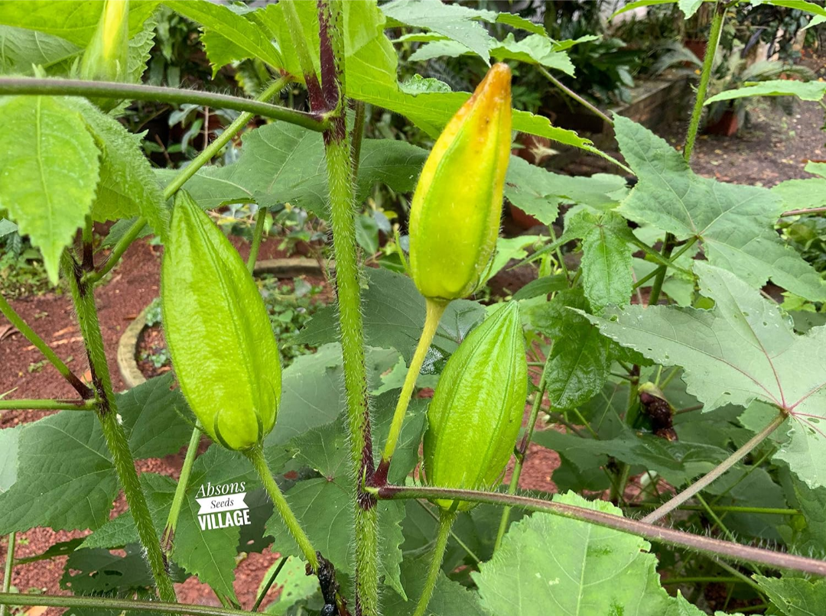
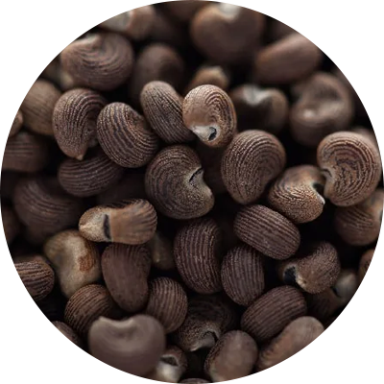
Flower - Solitary yellow , 7-10 cm long
Flowering period - August - November
Fruit - Capsule , Ovate , Hispid (rough with stiff hairs )
Fruitning period - October - January
Seeds - Black with an aroma of musk on rubbing with hands or soaked in water

Slide 8
लताकस्तूरी के नाम से यह बोध होता है कि इसकी लता होती है।
'निघण्टुरत्नाकर' में लिखा है कि इसकी लता दक्षिण में पाई जाती है परन्तु लता देखने में नहीं आती, इसका क्षुप ही होता है ।
चरक-सुश्रुतादि ग्रन्थों में मुखशुद्धि के लिये /मुख में रुचि / सुगन्ध लाने के लिये / मुख में धारण करने के लिये जातीफल, कटुक, पूग, कंकोल, ताम्बूल, सूक्ष्मैला, लवङ्ग एवं कर्पूर का उपयोग लिखा है। टीकाकारों ने कटुक शब्द का अर्थ लताकस्तूरी किया है।
कुछ लोगों ने कटुक का अर्थ लघुकक्कोल (छोटी कबाबचीनी) किया है तथा कक्कोल का अर्थ बृहत्कक्कोल (बड़ी कबाबचीनी) किया है।

Slide 9
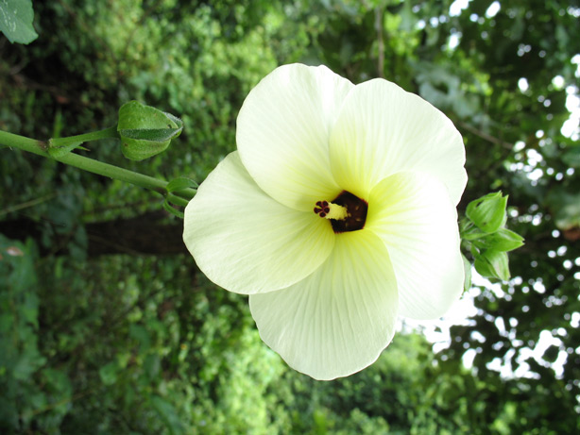
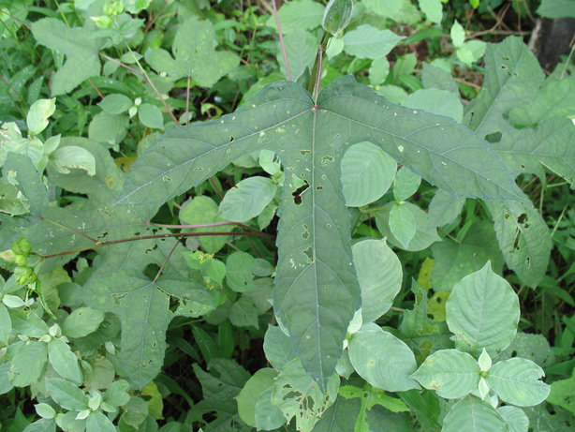
लताकस्तूरी के पौधे के सदृश एक अन्य पौधा Hibiscus tetraphyllus Roxb. होता है जिसे दुल्ला कहा जाता है।

Slide 10
Ras Panchak
Ras- Tikt , Madhur , Katu
Gun- Laghu , Ruksha , Teekshna
Veerya - Sheet
Veepak - Katu
Dosha prabhav - Kafa - Pitta shamak
Pharmacological actions - vrushya , deepan , expectorant
लताकस्तूरिका तिक्ता स्वाद्वी वृष्या हिमा लघुः ।। (Bha. Ni. )

Slide 11
Chemical composition
Leaves contains - beta sitosterol , myrecetin.
Seeds contains - volatile oil consists of sesquiterpene alcohol , farnesol , ambrettelide
Ambrettolide - responsible for musk like odour .

Slide 12

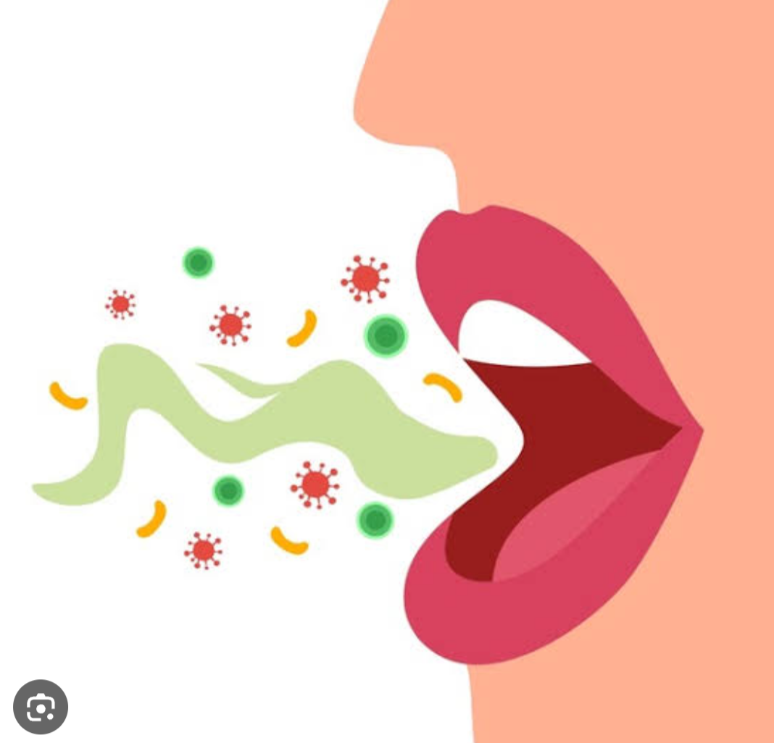

Karma
चक्षुष्य छेदनी शेलष्मतृष्णाव स्त्यास्यरोगहृत ।। (भा.प्र)
Kafa shamak- due to laghu , Ruksha , Teekshna , and Tikt ras
Pitta shamak - due to sheet veerya
Rochan, Deepan , grahi
Chakshushya
Mukh daurgandya nashak & mukh vaisadyakara
Mutral & basti shodhini
Vrushya
Hridya uttejak

Slide 13
चक्षुष्या छेदनी श्लेष्म तृष्णावस्त्यास्यरोगजित् |
(K.Ni)
गुणकर्म-
लताकस्तूरिका तद्वच्छीता बस्तिविशेधनी ।।
( Shu. Su. 46)
वाजीकरण
कफ निःसारक
नेत्र के लिए हितकर
तृष्णा
वस्ति -मुखरोगों

Slide 14
Aamayik prayog
Mutrakrichha rog - Mool swaras , Patra swara .
Netra rog - Sukshma churna lep .
Mixed with cosmetics , hair perfume & medicated oil for good odour
Used along with betel leaf to control respiratory problems and improves digestion.
Relieved menstrual pain by chewing the seeds .
Used as an oral antiseptic.

Slide 15
Fruits are consumed after cooking as vegetable (sāka).
The drug is also anti-convulscent.
Fant - 20-40 ml - used in kafa vikar , tamak swaas , jwar , mukh vran
Vidhi of kashaya / fant -
1tsp powder + 2 cups water —---------> boil it to 1 cup
Dry itching - mix with milk and used as ubatan
Shukra meha - beej churna is used
Swar bhang & mukh shoth - used as dhumpaan
Sarp dansha - churna mixed with madhya Saar .(Internal & local application)

Slide 16
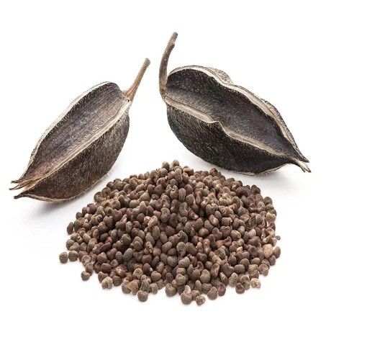
Part used - Seed
Dose - 2-4 gm of powder
Tincture - 4-8 ml
High dose (>8 ml ) - lead to headache and vertigo
Precautions - not used in pregnancy and lactation

Slide 17
Let's see some research
https://rdcu.be/dA9WB
1. Antioxidant -
The seed and leaf extracts of Abelmoschus moschatus possess significant antioxidant activity and could serve as free radical inhibitors.

Slide 18
2. Antibacterial - The plant possesses moderate antibacterial activity against bacteria and Candida
3. Against cancer cell - Hydroalcoholic seed and leaf extracts also exhibited antiproliferative activity against two human cancer cell lines

Slide 19
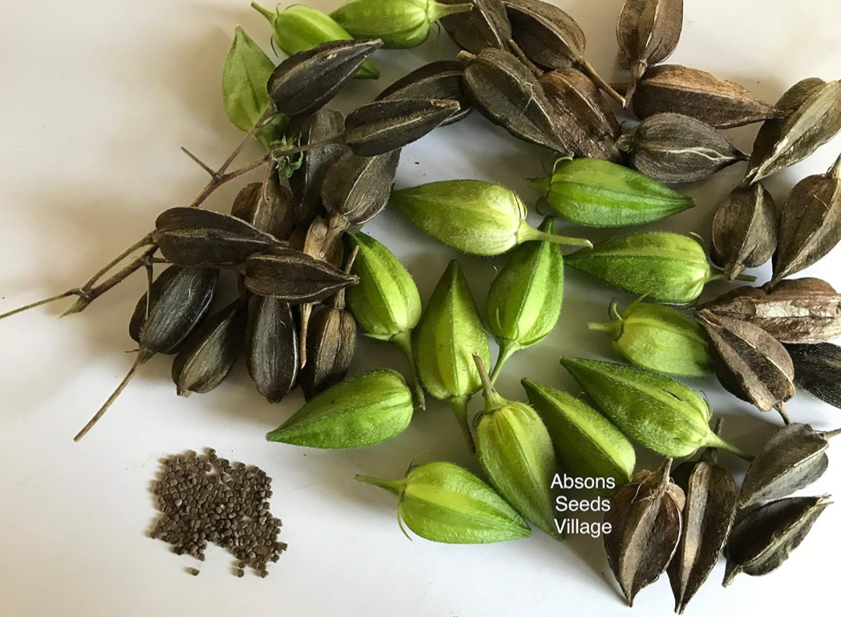

Slide 20
Thank you ☺️

