Slide 1


Slide 2

Classical Categorisation:
☺Bhav Prakash Nighantu: Vatadi Varg
☺Dhanwantri Nighantu: Aamradi Varg
☺Kaiydev Nighantu: Ausadhi Varg
☺Madanpal Nighantu: Abhayadi Varg
☺Astang Nighantu: Nyagrodhadi Gana
☺Hrudyadipika Nighantu: Aekpada Varg
☺Nighantu Adarsh (Bappalal Vaidya): Vatadi Varg
☺Priya Nighantu: Haritkiyadi Varg
☺Shaligram Nighantu: Vatadi Varg
☺Nighantushesh (Hemchandra Suri): Gulmakand

Slide 3
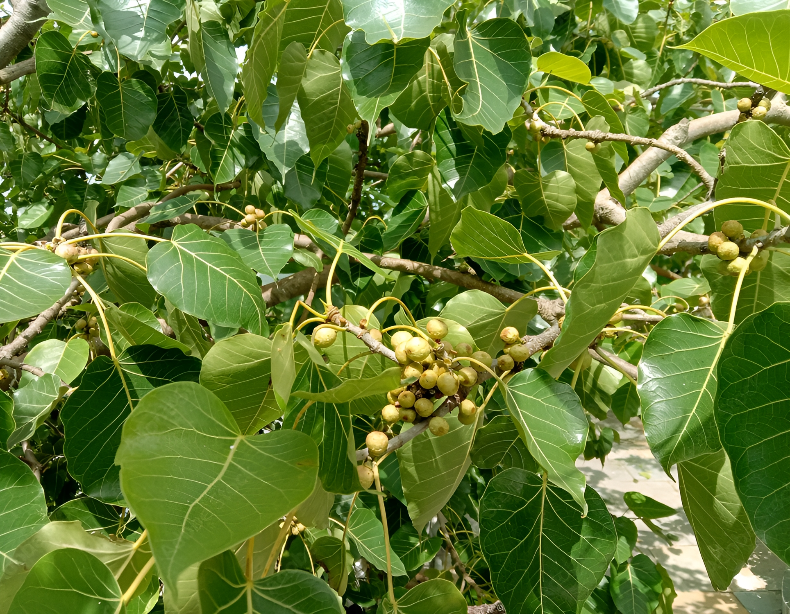
पीपल
Family: Moraceae
Botanical Name: Ficus religiosa L.

Slide 4
बोधिद्रुः पिप्पलो अश्वत्थश्च चल पत्रो गजाशनः।
पिप्पलो दुर्जरः शीतः पित्त श्लेषम व्रणास्रजित् ।
गुरू तुवरको रूक्षो वर्ण्यो योनि विशोधनः ।।
भाoप्रoनिo वटादी वर्ग (3)
The above shloka explains the synonyms, properties, and actions of the tree Pippal. The synonyms of Pippal are Bodhidru, Pippal, Asvattha, Chalapatra, and Gajasana.
Pippal is difficult to digest, cold in potency, cures the diseases of pitta, Sleshma, and Rakta, and heals ulcers. It is heavy in action, astringent in taste, drying promotes complexion, and cures the diseases of female external genitalia.

Slide 5
Morphological features as per Bhava Prakasha Nighantu:
☺It is a very large tree.
☺Aerial roots may be or may not be there.
☺Leaves- ovate, the apex is caudate.
☺Fruit-figs, in axillary pairs, sessile, dark purple when ripe.
Ayurvedic properties of Peepal:
☺Rasa (Taste) - Kashaya (astringent), Madhura (sweet)
☺Guna (Virtue) - Guru (heavy), Ruksha (dry)
☺Virya (potency) - Sheeta (cold potency)
☺Vipaka (post-digestion) - Katu (bitter)
☺Karma (Action)- Kapha - Pitta Shamaka
Distribution & Habitate:
☺All over india

Slide 6
Synonyms:
☺बोधिद्रु ~ गौतमस्य बोधप्रदः।
Gautam Buddha attained enlightenment while meditating
under the peepal tree.
☺पिप्पल ~ सूक्ष्मफलः।
Fruits are small.
☺अश्वत्थ ~ अश्व इव तिष्ठत्यस्मात् वाजीकरत्वात।
Used as aphrodisiac.
☺चलपत्र ~ चलानि पत्राण्यस्य।
Leaves are constantly shaking.
☺गजाशन ~ गजैरश्यते भक्ष्यत इति।
Leaves are eaten by elephant.

Slide 7
Karma (Action)- Kapha - Pitta Shamaka
☺Kapha Hara because of Kashaya Rasa and Katu Vipaka.
☺Pitta Hara because of Sheeta Virya, Madhura Rasa and
Kashaya Rasa.
☺Twak ( Bark): Mutrasangrahniya, Stambhana.
☺Pakva phala ( Ripe fruit): Snehana.
☺Twak (Bark): Anulomana- Mridu Rechana, Raktasodhaka,
Rakta Pitta Shamaka, Kaphaghna-svasahara.
☺Pakva phala (Ripe fruit): Varnya- Tvacya, Vranaropana,
Vedana Sthapana, Sothahara, Raktarodhaka,
Yonivisodhana, Daha Praashamana, Trishna Hara, Rocana,
Chardi Ghana.
☺Garbhasthapana, Vajikarana, Visaghna.

Slide 8
Phytoconstituents:
Bark has Arabinose, Mannose, Glucose, Flacourtin, Steroid, Ramontoside and Beta sitosterol.
Therapeutic uses:
☺Fruits, root and stem bark are used with milk as an aphrodisiac.
☺Ash of the stem bark is used in bronchial asthma.
☺Decoction of the bark is used to wash septic wounds.
Types:
☺ पारीष पीपल
☺ बेलिया पीपल ( नन्दी वृक्ष )

Slide 9
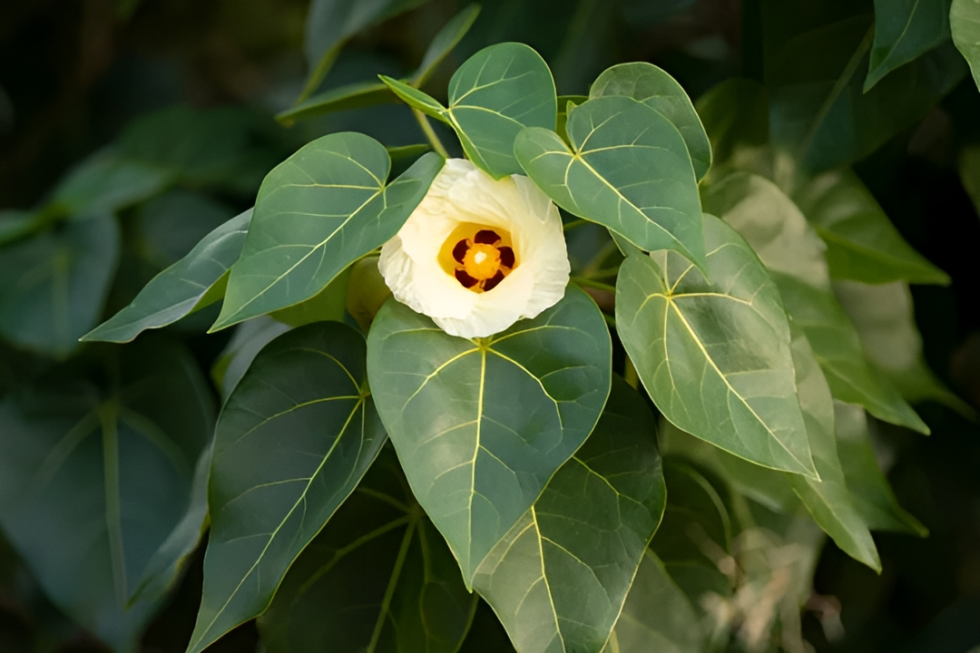
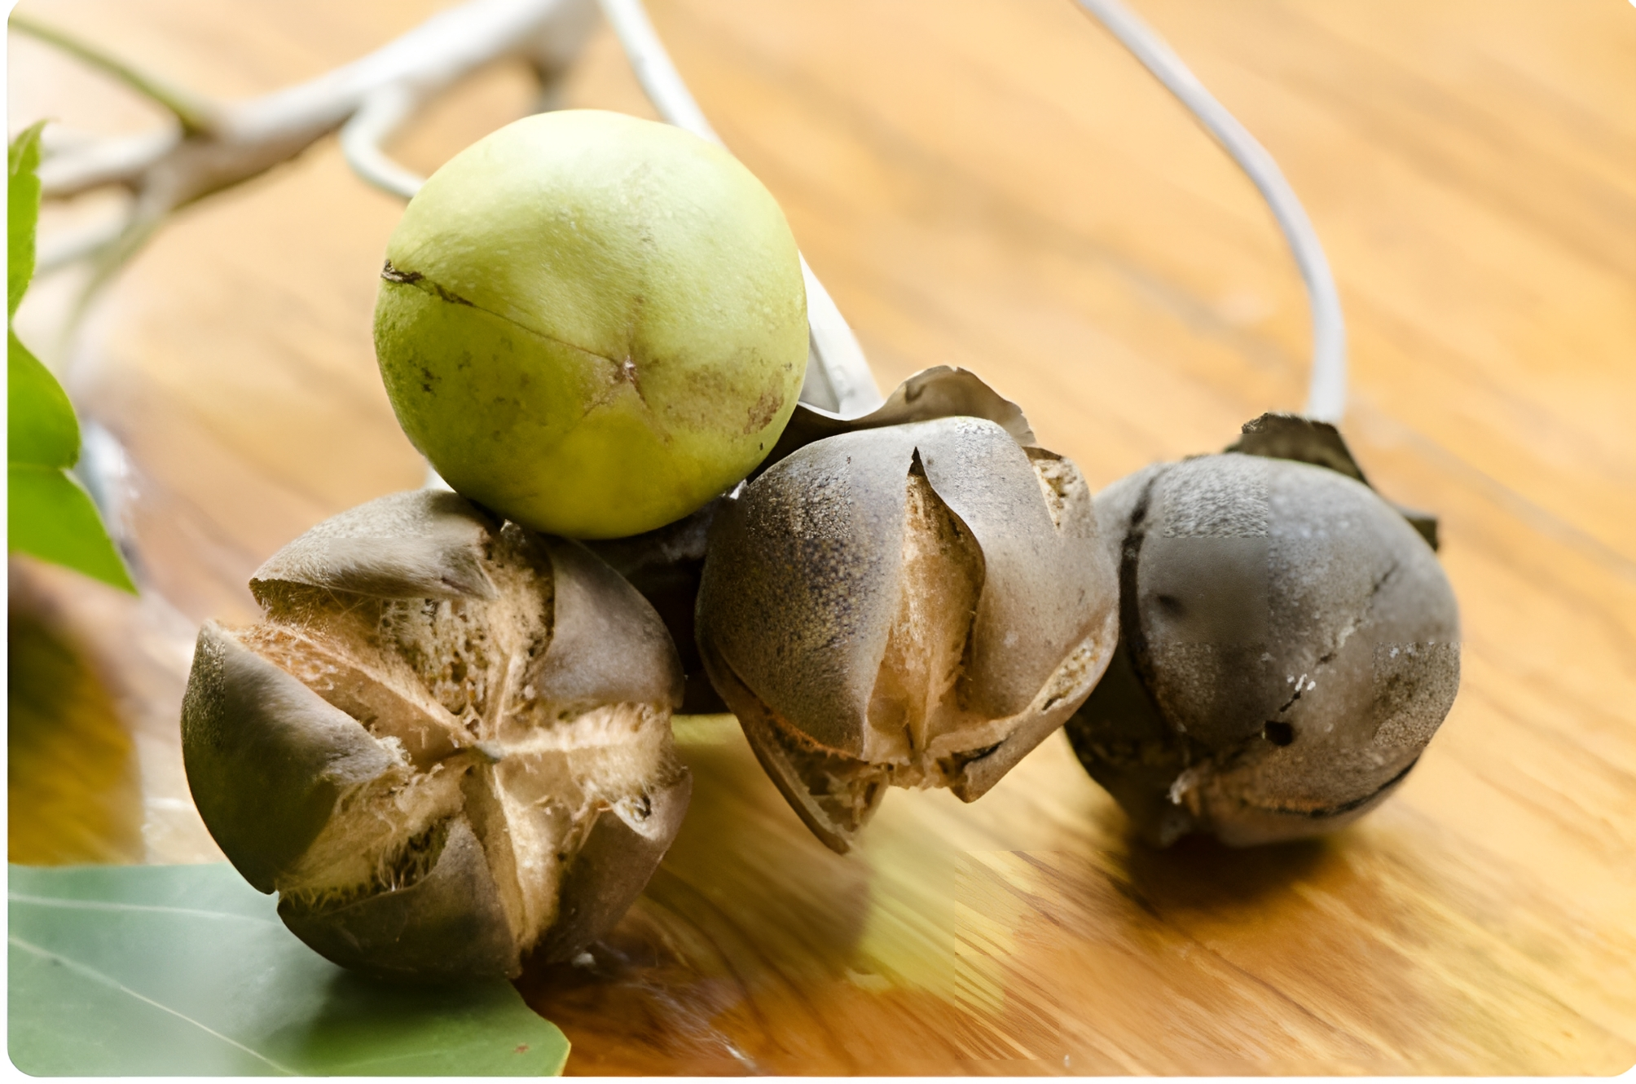
पारीष पीपल
Family: Malvaceae
Botanical Name: Thespesia populnea Soland ex Correa

Slide 10
Synonyms:
पारीषो अन्यः पलाशश्च कपिचूतः कमण्डलुः।
गर्दभाण्डः कन्दरालः कपीतनसुपार्श्वकौ।।
भाoप्रoनिo वटादी वर्ग (4)
☺पारीष, पलाश, कपिचूत, कमण्डलु, गर्दभाण्ड, कन्दराल, कपीतन,
सुपार्श्वक
☺पारीषः पारि, ब्रह्मज्ञान, इषः इष्यते। ( इसे गलती से बोधिवृक्ष समझा
गया। )
Gautam Buddha attained enlightenment while meditating
under the peepal tree.
☺Gardbhanda ~ Its fruits resembling the testis of donkey.
☺Kandral ~ Roots of Parisha goes very deep into the soil.
☺Kapitan ~ Fruits colour resembles that of monkeys skin
colour.

Slide 11
Properties:
पारीषो दुर्जरः स्निग्धः कृमिशुक्रकफप्रदः।
फले अम्लो मधुरो मूले कषायस्वादुमज्जकः।।
भाoप्रoनिo वटादी वर्ग (5)
☺Parisha Peepal is difficult to digest.
☺Unctuous (Snigdha) in properties.
☺Cause intestinal worms.
☺Improves sperm and semen quantity and quality.
☺Increase kapha dosha.
☺Parish tree fruits are sweet and sour in taste.
☺Root and bark of Parisha tree is astringent in taste.
Distribution & Habitate:
☺Usually found in coastal parts of India

Slide 12
Morphological features:
☺Medium sized evergreen tree.
☺Leaves are glossy green and heart shaped.
☺Flowers are bell shaped and yellow in colour like yellow ☺hibiscus type flowers.
☺Fruits are round in shaped look like goolar types fruits but
outer covering is very hard.
☺Seeds are looks like Erand seeds and present 5 in number.
Ayurvedic Properties:
☺Rasa: Kashay
☺Guna: Laghu, Snigdha
☺Vipak: Katu
☺Virya: Sheet

Slide 13
Phytoconstituents:
Populinin, Populnetin and Herbecetin Present in Flower
Therapeutic uses:
Ash of fruits mix with oil and applied externally to treat skin disorder such as Ringworm.

Slide 14
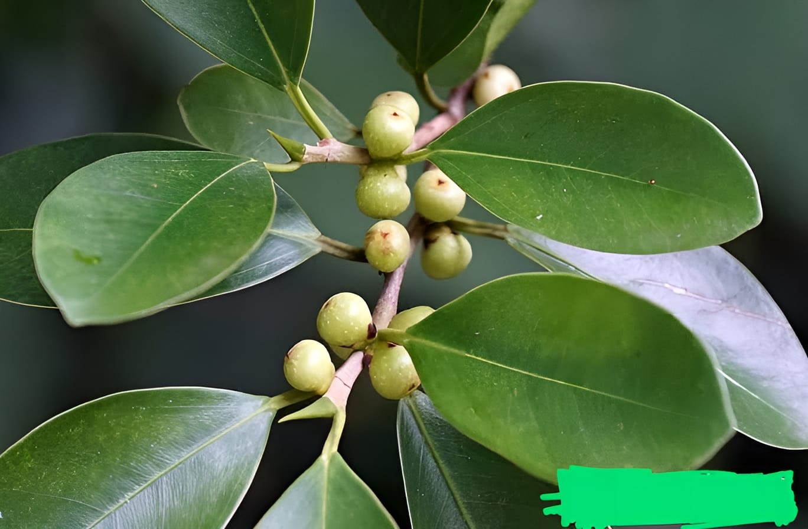
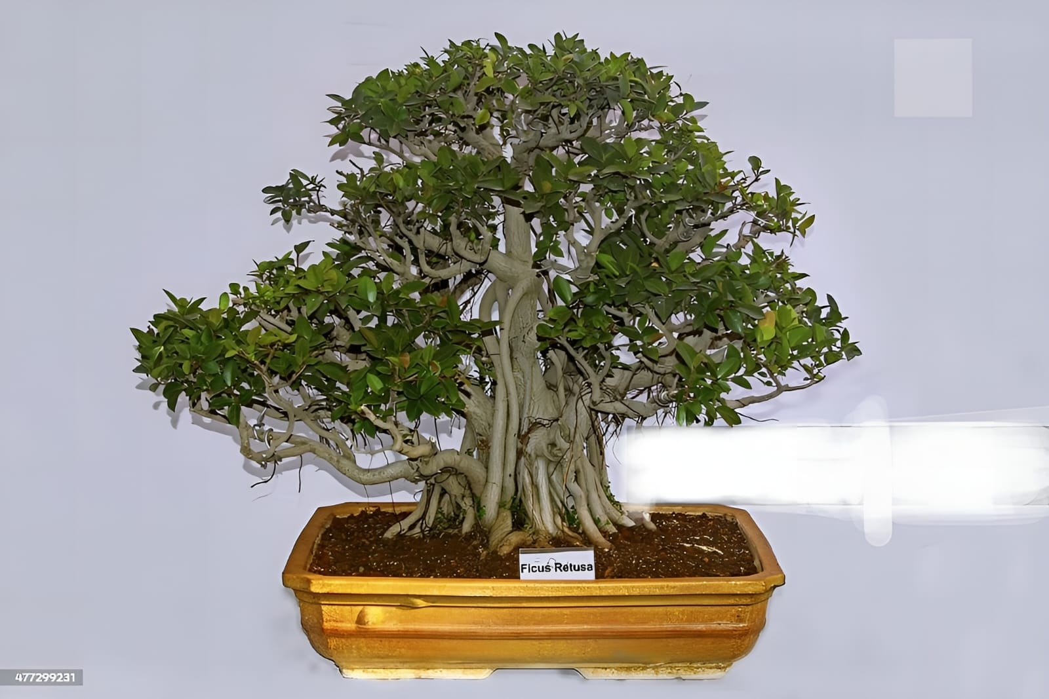
बेलिया पीपल (नन्दीवृक्ष)
Family: Moraceae
Botanical Name: Ficus retusa L.

Slide 15
Synonyms:
नन्दीवृक्षो अश्वत्थभेदः प्ररोही गजपादपः।
स्थालीवृक्षः क्षयतरू क्षीरी च स्याद्वनस्पतिः।।
भाoप्रoनिo वटादी वर्ग (6)
Nandivriksha, Ashwathbheda, Prarohi, Gajpadap, Sthalivriksh, Kshyatru, Ksheeri And Vanaspati
Properties:
नन्दीवृक्ष लघुः स्वादुस्तिक्तस्तुवर उष्णकः।
कटुपाकरसो ग्राही विषपित्तकफास्त्रजित्।।
भाoप्रoनिo वटादी वर्ग (7)
Madhur, tikt and kashay in taste, Katu in paka, Laghu, Grahi, Ushna in Guna and cures the disease of Pitta, Kapha and Rakta.

Slide 16
Distribution & Habitate:
Chota Nagpur, Bihar, Madhya Bharat, Lanka and Sundarvan
Morphological features :
☺Rapidly growing , rounded, broad headed , evergreen
tree can reach 50 feet or more in height with an equal
spread.
☺Leaves are glossy, dark green, leathery
☺Fruits are oval in shape
Ayuvedic Properties:
☺Rasa: Kashay
☺Guna: Guru
☺Vipak: Katu
☺Virya: Ushna

Slide 17
Chemical Constituents:
☺β Sitosterol, Lanosterol, Caffeic Acid
Karma:
☺Vranasodhana
☺Raktapittahara
☺Yonisodhana
☺Sophhara
Therapeutic Uses:
☺Bark decoction useful in skin disease.
☺Bark powder + Sunthi + Haridra useful in oedema.

Slide 18

THANK YOU

